Slide 1
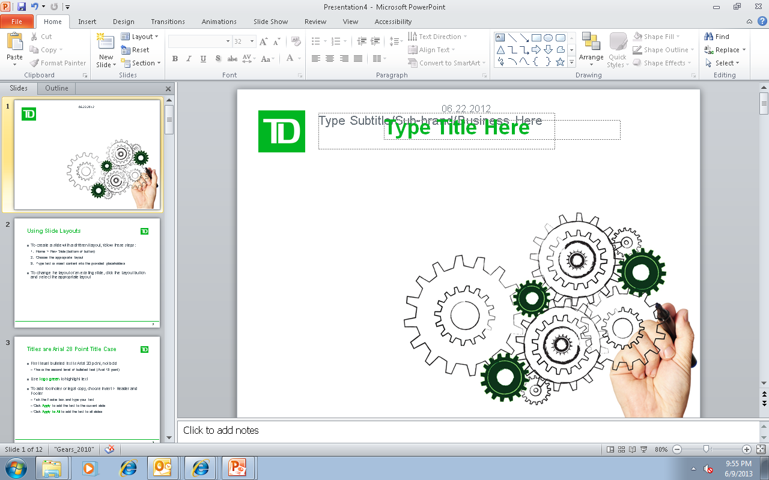
Delivering the Requirements Document
Requirements
Management Lifecycle
Prof. Tyler Krimmel
Notes:
SAY:
This course covers how to deliver requirements on a project as well as package them for review and approval in a way that is clear and usable for stakeholders.
Specifically you learn to use TD’s Business Requirements Document (BRD) to:
Package different requirements artifacts into a cohesive requirements package.
Tailor the requirements package for different scenarios.
Test the entire requirements package for quality, including the content you’ve included in the BRD and the underlying artifacts.

Slide 2
Introduction
Section 1
Notes:
SAY:
We’ll start by setting the context of delivering the BRD within RMLC.

Slide 3

Requirements FACTS
A 2001 e-project survey found that 55% of respondents defined poor requirements specifications as a critical risk to project success.
One study found that over 50% of software defects were discovered after testing, resulting in corrective costs 8 – 20 times relative to original.
NASA (2001) summarized that projects that spend less than 5% of budget on requirements result in an average of 125% cost overrun.

Slide 4
Class Discussion…
How have you identified requirements for past projects or initiatives?
How were requirements captured?
How did you know if they were right or wrong?
How many of you are creating your own projects and trying to determine what your ‘scope’ should be?

Slide 5
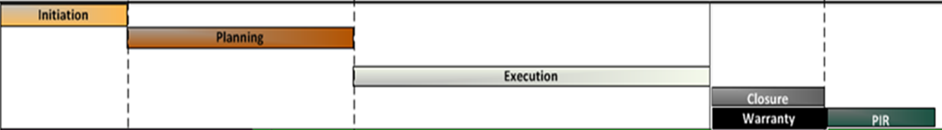
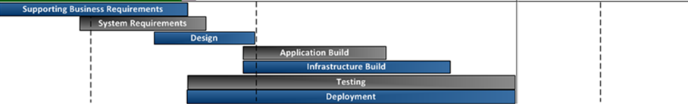
Project Delivery Methodologies
Seed Funding
Business Case
Delivery
AAR
Business Analysis Phase
(Ideation, Business Needs, Requirements)
Marketing, Pre-Sales
Marketing, Sales and Support

Slide 6
The Business Analyst and Requirements
A requirement is a usable representation of a need. Further, they describe the value that can be derived once fulfilled.
Plan
Elicit
Manage
Document and Analyze
Review and Communicate
Business
Stakeholder
Solution
Iteration

Slide 7

… but there are many types of requirements
Business requirements
Describe “why” the organization is undertaking the project
User requirements
Describe “what” the user needs or will be able to do with the product (user verb)
Functional requirements
Describes a systems behaviour when influenced by external systems - what the system “shall do” or “shall let the user do” (system verb)
Non-functional requirements
Describe what the system conditions not related to the system behaviour. Common stated as “shall be” - the attributes for developers or maintainers

Slide 8

Where are Requirements Captured?
Vision and Scope Documents
Use Case Documents
Software Requirements Specifications
Business rules
Business requirements
User requirements
Functional requirements
Non-functional requirements

Slide 9
Requirements Traceability
BRD Deliverables | Description
PO Statements
(Problem Opportunity)
Issue the project is tackling
In Scope items Beneficiary must be able to do what
L3 & L4 Process Maps L3 – Activities an actor must perform to fulfill a process L4 – Tasks an actor must perform to complete an activity in the L3
Use Cases (including business rules, data rules, etc.) Eg. Step 3 – Expected result, must display the following courses XXX YYY ZZZ
HLR's
(High Level Requirements)
MLR's
(Mid Level Requirements)
MLR's
(Mid Level Requirements)
Missing process maps
DLR's
(Detailed Level Requirements)
DLR's
(Detailed Level Requirements)
Missing details

Slide 10
Business Requirements Scope
Section 2

Slide 11
What is Business Requirements 'Scope'?
The portion of the ultimate vision that the current project will address. It draws the boundary of what’s in and what’s out for your project.
Software Requirements – Karl Wiegers, 2nd Edition
…but, what are the ‘What’s?
Setting the 'Business Requirements Scope' means you determine what work you are about to study, what other pieces of work that surround it, and what flows of information make the connections
Mastering the Requirements Process – Robertson and Robertson, 2nd Edition
Notes:
How is Scope Usually Defined?
What’s In
What’s Out
What are the ‘What’s???’ Depends on the adjective in front of the ‘Scope’ Project, Product, Business, Technical…. (this should be referenced following the first click)
Depends on the type of projects Data conversion, Business Process
SCOPE = BOUNDARY – but BOUNDARY for What? And more importantly… how do we define this in the RMLC Methodology?

Slide 12
How to obtain Requirements Scope?
Requirements Scope is the evolution of Business Needs. The evolution must identify:
Stakeholders/Beneficiaries - those who will derive benefit
"what" Stakeholders/Beneficiaries must be able to achieve/do
Technology enablement – the notion that technology will be leveraged
Boundary of Work
Stakeholder
Stakeholder
Stakeholder

Slide 13
Defining the Needs: Business Requirements
Creating your Problem/Opportunity Statements

Slide 14
Problem/ Opportunity Statements
What is driving the need for this project?
Does NOT recommend a solution
Forms the basis for High Level Requirements
Used to derive the Business Need
Problem statement:
Describes the nature and extent of the problem (factual, quantified, concise)
Identifies factors/variables that contribute to the problem
Syntax: Currently, the problem of [what], affects [who], the impact of which is [what, where, when]
Opportunity statement:
Outlines a chance for advancement or progress
Syntax: The opportunity is to [do something] that would enable [who] to [achieve something]
Notes:
SAY This is another key question to be answered as part of this thinking process.
REVIEW THE SLIDE
ASK:
Can anyone share an example of a project for which the business need was not clear, and what happened?
Why is it important to clarify the business need? What are the implications of an unclear need?
EXPLAIN: An unclear business need leads to:
Time and cost overruns
Unclear objective
Poor quality requirements
Change impacts
Process impacts
Project change requests
SAY We are going to spend some time on how to clarify the business need.

Slide 15
Sample Problem/ Opportunities ‘Before’ and ‘After’
Before
After
Retail branches have no idea when PCs, monitors etc. will arrive.
Currently branch staff have no visibility into the status of equipment requests or the fulfillment date.
Symcor takes too long to produce client statements.
Currently Symcor, a printing contractor, uses a manual, resource intensive process to obtain client statement information and produce client statements.
We need to improve efficiency of online help desk calls.
Currently help desk agents don’t have a single dedicated online knowledge centre and have to search several different data sources to answer client calls to the online helpdesk.
Notes:
DO:
Review the ‘before’ and ‘after’ statements.
Emphasize the value of ‘5 whys’, because without it, the results can be very different.
Solicit feedback from the groups on whether the ‘after’ statement answers their clarifying questions.

Slide 16
A REAL Example: RMLC Sample ‘Before’ and ‘After’
Before
After
PO02 - classroom training doesn't provide an automated registration process
PO02 – Currently, registrants of classroom training have not been provided with an automated registration process. This has resulted in many manual errors throughout the registration process when registering for workshops.
Notes:
DO:
Review the ‘before’ and ‘after’ statements.
Emphasize the value of ‘5 whys’, because without it, the results can be very different.
Solicit feedback from the groups on whether the ‘after’ statement answers their clarifying questions.

Slide 17
Class Case Study: Sam’s Pizza
Sam’s Pizzeria is a family-managed business that was launched in East-Toronto in 1991. In 23 years of operation, Sam’s has grown to service its clients across the entire GTA with 7 locations. While word of mouth has helped to grow and sustain a thriving business, Sam’s Management realizes that to better service its customers, and continue to complete with larger competitors, that it must create an online presence.
Sam’s Pizzeria has decided to implement a web-based software application to support their order taking, payment and delivery processes. This application will be used by both staff and clients to facilitate the ordering process.

Slide 18
Delivering High Level Requirements – Defining Requirements Scope

Slide 19
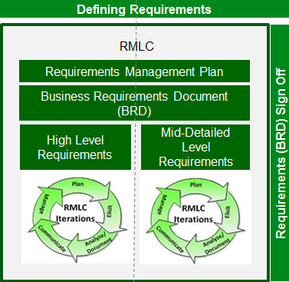
High Level Requirements…
Address a business need, e.g. a business problem or opportunity; describe what the beneficiary must be able to do / receive from the solution
Define the boundary of business requirements work – the ‘business requirements scope’
Form the basis for mid-level / detailed business requirements
How do you create these????
Notes:
DO:
Use this slide to provide your own answers to the previous questions.
NOTE:
If necessary, speak to how business requirements scope is input to project scope.
Requirements scope defines the boundary of business requirements activities.
Project scope includes everything that the project will deliver.
(Do not bog down on it here.)

Slide 20
What is a Business Context Diagram?
External view of the scope of the Requirements
Created from a business, not system perspective
Consists of diagram and descriptions of:
Requirements Scope Area – focus of the requirements scope
External Entities – out of scope of the requirements work
Information Flows between Requirements Scope Area and External Entities
Notes:
Requirements = business requirements + readiness requirements
“external” view of the scope. The circle encapsulates all the internal scope, but we are not making it visible in this diagram. HLR will include both external and internal view (exploding what’s inside the circle).
External entities impacted but not directly changed by the Requirements scope area;

Slide 21
Requirements Scope Area
People, processes, and technology in scope and may encompass one or more :
Systems/Applications
Business departments, user groups, etc.
Business processes
Examples:
Client Document Services
Online trading platform
Is represented by a single labelled circle in the diagram and described in the table
Describe only in the context of the project, not what it is overall
Only one per project!
Requirements Scope Area | Description
Client Document Services | Area responsible for providing storage and access to client documents e.g. tax receipts, wills etc.
Notes:
We need to make sure they understand that circle = area in scope, so we don’t end up with TD there ☺
Need to emphasize that Names should be short and sweet, all the details go into description – re. answer to the question what if it is Marketing and Operations and so on are part of the business scope area.

Slide 22
External Entities
Entities that directly interact with Requirements Scope Area via inputs and outputs. Can be:
Human, e.g. Client
System, e.g. Client Account Information
Organization, e.g. Equifax
Are outside of scope
Are impacted by or impact the Requirements Scope Area in scope
Are represented by labelled squares
Described in a table
As a source or destination of input or output
Why our Requirements Scope Area interacts with them
Not what they do overall
External Entity | Description
eServices | External area that generates documents such as statements, confirmations and tax receipts for TD clients
Client | Client or client designate who can view, upload, download or delete client documents
Client Advisor | TD employee who can view, upload, or download client documents based on client preferences

Slide 23
Information Flows
Business information passed as inputs and outputs to and from the Requirements Scope Area, e.g. Travel Information, Travel Options
Focus on meaningful information (do not go to details of interactions request/response level)
Diagram does not show when inputs or outputs occur, i.e. no sequence, not a process
Are represented by labelled directional arrows and described in a table
Include multiple inputs as one arrow if part of the same goal of the interaction; otherwise separate arrows
Describe what information is contained in the inputs/outputs
Information Flows | Description
Client Document | Any document in an electronic format that the client or client advisor can upload, download, store, view or delete through Client Document Services
Client Preferences | Preferences about the clients use of Client Document Services e.g. acceptable client delegates, storage capacity, who can see, upload or delete client documents
Client Documents | Client documents, such as statements or tax slips, that are generated and stored electronically in client document services
Notes:
Emphasize when multiple flow lines vs. single flow lines – based on the goal of the interaction

Slide 24

Class Activity: Acceptable Business Context Diagram?
Notes:
What changes, if any need to be made to include this as part of a High Level Requirements document?

Slide 25
Elements of Quality High Level Requirements
Stated from the perspective of someone who will benefit
Unique identifier (e.g., HLR01)
Technology / solution free, but identifies manual vs. technology enabled needs
Structure: <Beneficiary> must <Do/Be Able to Do> <What>
Examples:
HLR01 Customer must receive monthly statements online.
HLR01 Provide ability to generate monthly statements online.
Notes:
SAY:
Here are some of the elements of quality high level requirements.
DO:
Review the slide.

Slide 26
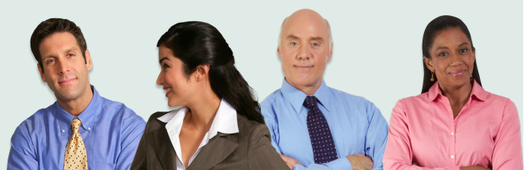
Group Activity
Which of these are acceptable high level requirements?
The system shall generate monthly profit loss reports.
Customers must be able to obtain quotes for GICs, Term Deposits, TBills etc.
TD systems will interface with Tokyo market systems and will provide market data for Singapore securities.
Notes:
NOTE: none of these are acceptable.
SAY:
Just as a business need must be clear, concise and specific, a high level requirement must be properly formed.
Here is a list of sample high level requirements. Let’s take a minute to identify which ones are effective as written. If not, what questions do they raise?
DO:
Review each high level requirement and ask whether it is effective as written.
If not, ask participants what questions they raise.
ANSWERS:
Not acceptable as written. Questions it raises: Who receives these reports?
Not acceptable as written. Questions it raises: In the system or manually?
Not acceptable as written. Questions it raises: Solution not requirement. Who will benefit from it? Who will do what?

Slide 27
A REAL Example: RMLC Case - HLRs
Based on the P/O Statements, consider HLRs that address the needs identified: Currently, registrants of classroom training have not been provided with an automated registration process. This has resulted in many manual errors throughout the registration process when registering for and completing workshops.
HLR | Description | Trace
HLR01
HLR02
HLR03
HLR04
HLR05
HLR06
HLR07
Notes:
DO:
Review the case study answers on the slide.

Slide 28
A REAL Example: RMLC Case - HLRs
HLR | Description | Trace
HLR01 | Registrant must be able to request registration for classroom modules online, in English
HLR03 | Registrant must be able to review information on classroom modules online, in English
HLR05 | Registrant must receive notifications on their registration status for classroom modules in English, via email
HLR06 | Registrant must be able to take pre and post course tests online, in English
HLR07 | Registrant must be able to take post course survey online, in English
Notes:
DO:
Review the case study answers on the slide.

Slide 29
Class Case Study: Sam’s Pizza
Sam’s Pizzeria is a family-managed business that was launched in East-Toronto in 1991. In 23 years of operation, Sam’s has grown to service its clients across the entire GTA with 7 locations. While word of mouth has helped to grow and sustain a thriving business, Sam’s Management realizes that to better service its customers, and continue to complete with larger competitors, that it must create an online presence.
Sam’s Pizzeria has decided to implement a web-based software application to support their order taking, payment and delivery processes. This application will be used by both staff and clients to facilitate the ordering process.

Slide 30
Delivering Mid- and Detailed Level Requirements

Slide 31

Discussion Questions
Why is it critical to get mid-level requirements right?
How can we ensure we get it right?
Notes:
DO:
Pose the questions on the slide to the group and gather the perspectives of the participants.
Ask for their experiences on projects that got this step right / wrong.
After the group discusses each question, debrief by emphasizing :
Getting this part correct is critical to delivering the details.
Review this information with your Business and Technology Stakeholders / SMEs and ensure everyone has agreed to the future state.
If there questions and concerns that cannot be flushed out, ensure that it has been documented in the Requirements Issues Log and that everyone has agreed to the approach.
These outstanding items will cause rework and PCRs if not remedied.

Slide 32
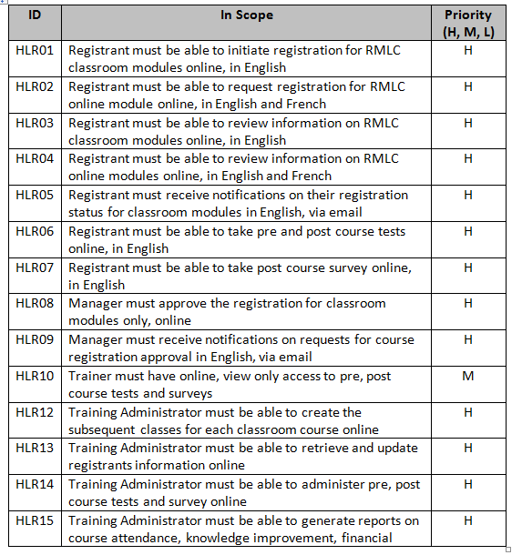
High Level Requirements
High Level Requirements (HLR) provides context to what the “user” not the system is do.
The standard is writing HLR is:
<Beneficiary – the person> must be able to <what>?
Distilling HLR to Verb + Noun helps to build process diagrams
Verb + Noun
Example: Initiate Registration

Slide 33
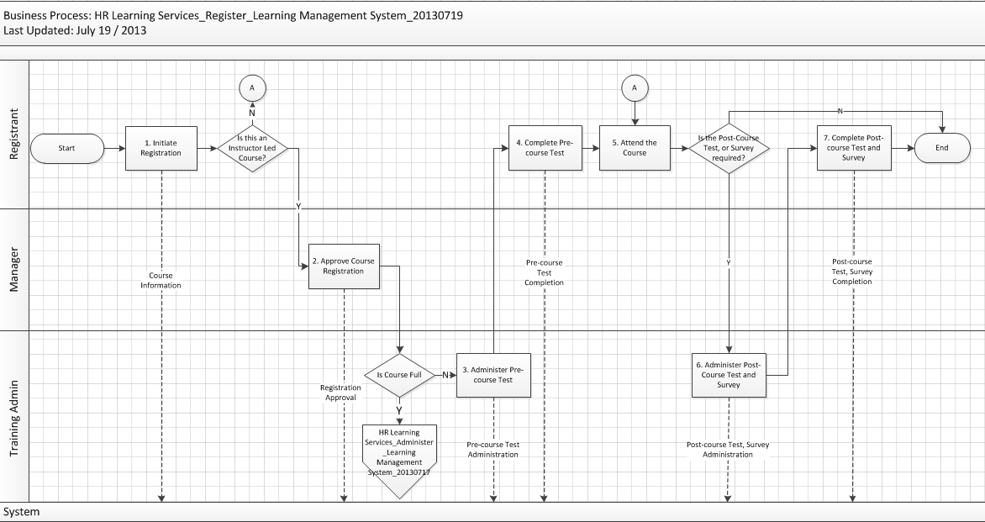
Mid Level Requirements
Mid-level Requirements (MLR) are the business process diagrams. Leveraging the HLR statements, a L3 business process diagram can be create.
Off –page indicator links to another process diagram to provide end to end view

Slide 34
… but, what exactly is a Business Process?
A repeatable series of activities that produces value for one or more stakeholders.
Process
Input
Valuable Output
Activity
Activity
Activity

Slide 35

BPM Notation Standard
The following is a summary of the key symbols and descriptions that comprise the standard BPM Notation:
Symbol
Description
Symbol
Description
Lanes
Swim lanes - Horizontal bands that represent the actors, with the swim lane names at the left side of the diagram
Sub Process - Used to indicate that more detailed process documentation is available for a given activity on a process map
Swim lanes
Sub Process Shape
Activity / Task - A step in the process that transforms an input into an output. The name of the activity or task is written inside, and should always start with a verb
Document - Identifies when the output of an activity is recorded on paper, such as a printed output. The name of the document is written inside the symbol
Activity / Task
Document
Decision - Identifies a decision or branch point in the process. The question requiring a decision is placed inside the symbol and each path emerging from the decision is labeled with the options
Data Object - Identifies when the output of an activity is a data object, such as an online form
Decision
Data Object
Terminator - Identifies the beginning or end of a process. “Start” or “End” may be written inside
Delay - Identifies when something must wait; the delay symbol tells the reader that the activity is taking longer than it should
Terminator
Delay
Activity Connector - Joins activities / tasks and indicates the sequence of activities / tasks
System Connector - Used to show the flow of information between activities and systems
Activity and System Connectors
Manual Activity - Any activity that has to be completed manually (such as filling out a customer signature card)
On Page Reference - Identifies where a process continues on the same page, as indicated by the numbering system. Numbering is placed inside the symbol
Manual Activity
On-Page Reference
Preparation Activity - A preparation activity, such as getting a document ready for a customer to sign
Preparation
Off Page Reference - Identifies where a process continues on another page of the business process map, as indicated by the numbering system. Numbering is placed inside the symbol
Inspection Activity - An inspection or measurement activity, such as reviewing a Mortgage Check Sheet prior to approval
Off Page Reference (outgoing & incoming)
Inspection
Group - Used to group activities over two or more swim lanes to indicate that multiple functions perform the same activity
Storage - Represents the database or system in which information is stored or imaged; it may be the Book or Record or a temporary holding cell for information
Group
Storage
Annotations – Allows for providing additional text information to the reader and when noted with a "C#" it is used to provide additional text details of a process control for SOX and pRCSA (Risk) regulatory compliance
Phase Marker – Used to indicate a distinct grouping of activities
Annotation
Phase Marker
<System Name>
System Bar – Each system is represented by a system bar and shows what technology systems are used to support activities and to send or receive information
Time
Interval Description
Timelines - Used to indicate the various cycle times of the activities being completed
System Bar
Timeline

Slide 36
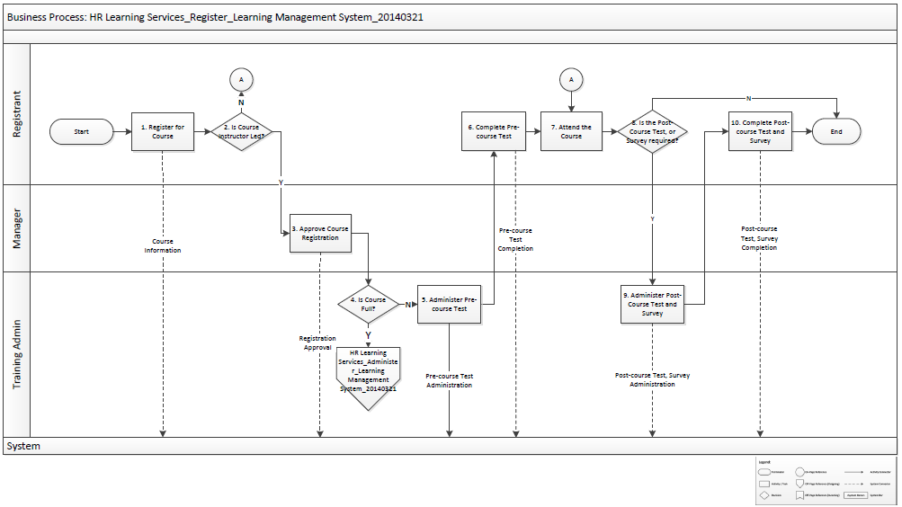
Example BPM
Notes:
Example: There was a rule that was missing in step 4 which should have stated: "No greater than 15 people per class. If 15 people are enrolled, approved by the manager and has complete the pre-test, then create a waitlist of anyone trying to register and have Giulia create a new course.
SAY:
The team created two L3 process maps. This is the first L3 process map.
This is what a Level 3 process map looks like.

Slide 37
RMLC - Level 3 Example ‘As Is’
HLR01 | Registrants must be able to take pre and post course tests within LMS, in English, for the classroom training courses. | H
HLR02 | Registrants must be able to take post-course survey within LMS, in English, for the classroom training courses. | H
HLR03 | Registrants must be able to obtain the Business Analysis Body of Knowledge (BABOK) guide from LMS. | M
Notes:
Example: There was a rule that was missing in step 4 which should have stated: "No greater than 15 people per class. If 15 people are enrolled, approved by the manager and has complete the pre-test, then create a waitlist of anyone trying to register and have Giulia create a new course.
SAY:
The team created two L3 process maps. This is the first L3 process map.
This is what a Level 3 process map looks like.

Slide 38
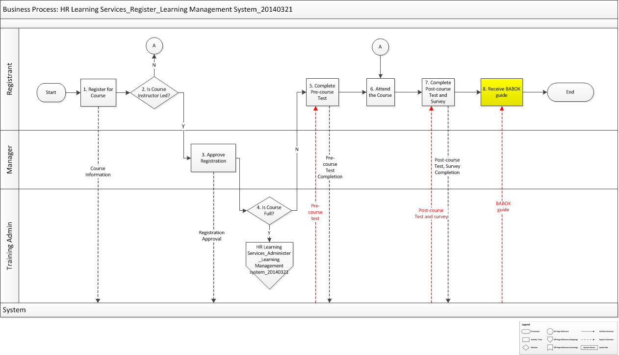
RMLC - Level 3 Example ‘To Be’
Notes:
Example: There was a rule that was missing in step 4 which should have stated: "No greater than 15 people per class. If 15 people are enrolled, approved by the manager and has complete the pre-test, then create a waitlist of anyone trying to register and have Giulia create a new course.
SAY:
The team created two L3 process maps. This is the first L3 process map.
This is what a Level 3 process map looks like.

Slide 39
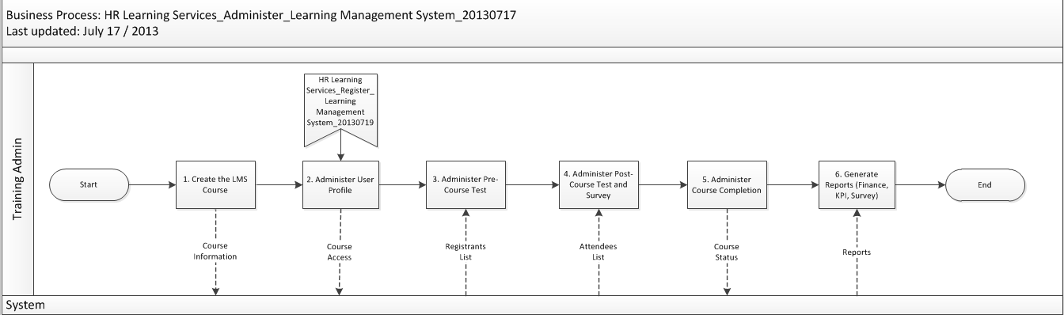
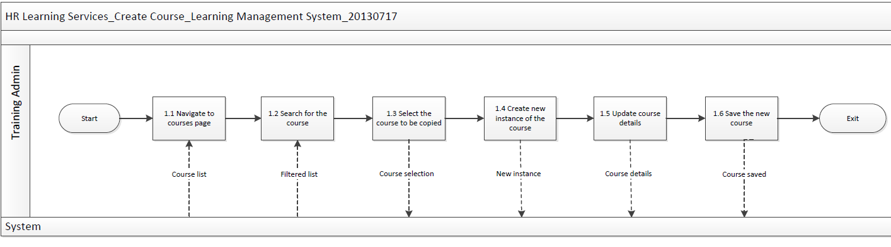
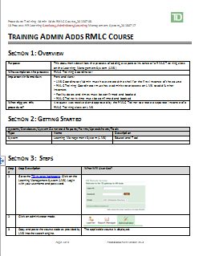
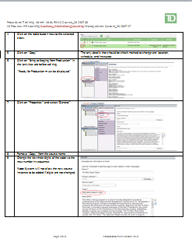
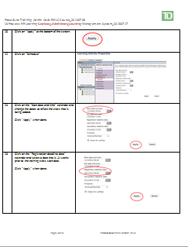
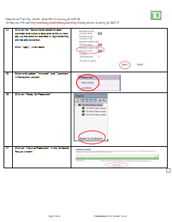
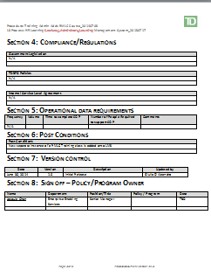
Process Diagram to Use Cases
LOW
Level 3: Processes
LEVEL
OF
DETAIL
Level 4: Activities
DLR – Business Use Case
Level 5: Tasks
HIGH
Notes:
YANA
What do we mean by alignment? SOPs are a
Level 3
In level three the focus is more specific. We are talking about a set of activities required to complete a process and meet a business objective. Our scope is specific to a particular product, channel or customer type. In this level our actors are likely to be teams/roles. At this level of mapping the goal is to have the map sufficiently detailed such that a reader can distinguish roles and responsibilities between actors.
An example "Welcome Customer" could be a level three activity
Level 4
In level four the focus becomes even more granular as we move to talk about a set of tasks which support level three processes. Again, here we are looking at supporting steps required to achieve the required outputs. In this level our actors are likely to be roles. At this level of mapping the goal is to have the map sufficiently detailed such that an actor can understand the main steps they need to follow to perform their job.
An example: "Greet Customer" and " Discuss Needs " may represent some Level 4 activities that are part of "Welcome Customer"
Today our focus is at the Level 5
Level 5 At a level five – the highest level of granularity we are talking about specific steps required at the actor / resource level
USE CASES level of detail
An example: "Welcome Customer" can be broken down to explain step by step how the interaction between the CSR and the customer occurs. For example there may be directions on exactly what to say when the customers enters etc.
********
Here is an illustration of what we have discussed
LMS process at L3 "Administer LMS"
L3 – Create LMS Course (at the Process Level)
L4 – Navigate to home page , search the course , select the course and other supporting steps/subtasks
L5 – We are at a step by step view of the entire process: where to click , how to select items from a dropdown menu etc.
RMLC , When we are talking about requirements we are talking about L3 & L4.
At level 4 we translate to business use case

Slide 40
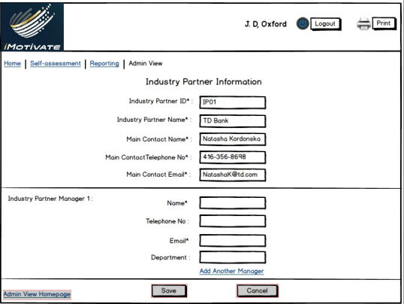
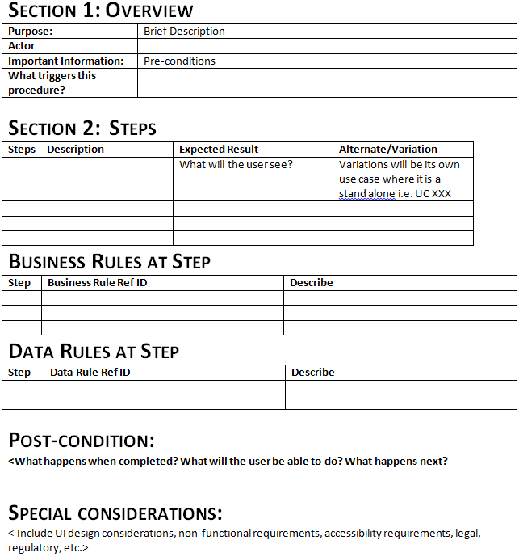
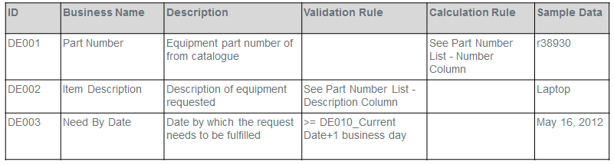
Level 5 Example: Reviewing Use Case Template, Wireframes, and Data Reqs

Slide 41
Identifying Rules in the Use Cases
Steps | Description | Expected Result | Alternate/ Variation | Trace Ref ID
S1 | Search for “RMLC” Course | List of RMLC courses displayed (“TD Boot Camp”, “RMLC Overview”, “Requirements Scope Analysis”, “Requirements Planning”, “Delivering the Business Requirements Document (BRD)”, “Business Process Management (BPM) and Use Cases”)
S2 | Chooses the course from the list | Course information displayed (availability, registration deadline, status) | END
S3 | Reviews class details | Class is selected, class details displayed (location, date, time, Manager’s approval required)
S4 | Requests Manager’s Approval | 1. Class status displays “Pending Approval” 2. Registrant receives email notification EN01 3. Manager receives email notification EN02
What course information?
What is an "RMLC" course?
What course details?
Will courses always be displayed?
Is Managers Approval always required?
How long can the status "Pending Approval" exist?
Notes:
DO:
Review the cells and discuss how the template is filled out for the use case steps.
Warn that these cells under Alternate/Variation can become quite long and when they do, the author should consider calling out the detail as an alternate flow in lieu of putting entire flow in the cell.

Slide 42
The Requirements Package
Section 3
Notes:
SAY:
Let’s take a look at the components of the BRD.

Slide 43
Discussion Questions
What is the difference between ‘requirements deliverables’ and the ‘requirements package’?
What’s the purpose of the requirements package?
Notes:
DO:
Pose the questions on the slide to the group and gather the perspectives of the participants.
After the group discusses each question, debrief with the points below.
TALKING POINTS
What is the difference between ‘requirements deliverables’ and the ‘requirements package’?
Requirements deliverables are the actual artifacts which contain requirements, such as business process maps, use cases, data.
The requirements package is a collection of requirements deliverables organized for easy consumption by stakeholders including the Business Owners and Subject Matter Experts (SMEs), Technology, QA.
What’s the purpose of the requirements package?
The purpose of the requirements package is to:
Communicate the business requirements (the ‘what’ not the ‘how’) at a level of detail and in a way that can be understood by the stakeholders;
To ensure the RSME has interpreted the ‘ask’ correctly; and
To communicate the business requirements to the ‘downstream’ teams who need to work from these requirements.
Objectives of the requirements package are:
To gain agreement with stakeholders
To provide a foundation to communicate to a technology service provider what the solution needs to do to satisfy the customer’s and business’ needs
To provide input into the next phase for this project
To describe what not how the customer/business needs will be met by the solution
Move to the next slide to debrief further.

Slide 44
Introducing the Requirements Package
The Requirements Package used to communicate underlying requirements deliverables. It is;
Is a stand-alone document
Organizes requirements artifacts for easy consumption by requirements stakeholders
Is highly flexible
Notes:
DO:
Review the slide.
TALKING POINTS:
TD’s package takes the form of the Business Requirements Document (BRD) with the underlying requirements artifacts, such as the process maps and use cases, either embedded within or linked to the BRD.
The requirements artifacts, e.g., process maps and use cases, are stored individually and simply pulled together in the BRD.
The BRD is focused on requirements artifacts, referencing additional project documentation to avoid duplicating work.
An important message is that the BRD is meant to be flexible. It is not meant to turn RSMEs into ‘template zombies’.
The BRD has been streamlined down to the essentials and contains core components only.
Some sections of the BRD are mandatory in every package.
Other sections may not be required depending on the needs of the project; for example, for a rebranding project, business processes or system interactions do not change, therefore the package will only include UI mockups.
Additional sections can be added following best practices (e.g. model driven).

Slide 45
A New Approach to the Requirements Package
Requirements deliverables – e.g., process maps, uses cases – are individual artifacts
The BRD becomes a package to pull together individual artifacts
The Requirements Management Plan determines which artifacts are developed and packaged
RSMEs need to educate business stakeholders on what the new requirements package will look like
Notes:
DO:
Review the slide
TALKING POINTS:
The requirements artifacts, e.g., process maps and use cases, are stored individually and simply pulled together into a package. That way, they can be easily located in future and reused.
There may be more than one RSME working on various requirements artifacts, and those bits and pieces will get pulled together for the package.
You’ll find that BRD looks different from previous versions. Rather than it being a very long document, it now contains references to linked or embedded documents. It acts as a package to pull together separate artifacts.
Delivering requirements is an iterative process. The RMP plan specifies what artifacts you develop, when, and which artifacts will be pulled together into each package.
In some cases, it won’t be only the RSME providing all the components of the package. Supporting teams may also contribute artifacts. For example if user interface requirements are included in the package, they may take the form of user interface mockups, and these artifacts might be contributed by visual designers.
It will be very important to set the expectation with your requirements stakeholders on what the new requirements packages will look like BEFORE they receive it.

Slide 46
Artifacts in the Requirements Package
Business Process Models
Use Case Diagram
Use Cases
Data Requirements
Wireframes
Non-Functional Requirements
Traceability
RMP
Problem/Opportunity Statements
Business Opportunities/Benefits
Context Diagram
Stakeholder Analysis
Requirements Statements

Slide 47
Three Levels of Business Requirements
The Requirements Document supports an iterative approach to delivering requirements
There are three levels of business requirements:
High level – requirements scope
Mid-level – such as process maps, use case diagram
Detailed – such as use cases, user interface, data / reporting / other requirements
The Requirements Management Plan drives the components included in each requirements package
Notes:
DO:
Review the slide.
TALKING POINTS:
The BRD has clear sections for high level, mid-level and detailed requirements. (Note: Depending on the project, it may not be necessary to produce all artifacts, e.g., process maps may not be not needed if the process isn’t changing/affected.)
This imposes a clear and consistent beginning/end and level of depth for each level of requirements.
However the BRD is not necessarily completed in order of the sections in the document.
The RSME will have planned out the requirements artifacts they need to develop and the order in which their work needs to be completed, and will have captured that in the Requirements Management Plan.
The RSME will then execute the work as per the RMP.
When you complete the BRD, you are simply bundling various components into a requirements package as per the RMP.
Therefore the Requirements Management Plan drives the components in each requirements packages.

Slide 48
Work Iterations, Reviews and Approvals
Section 6

Slide 49
Planning Requirements Iteration
1.Prepare
2.Elicit
3.Analyze and Document
4.Communicate
5.Manage
5-10 business days of effort
Notes:
Finish slide and then open up to show the RMP template and walkthrough and explain it.
If PM asks: Can you get me the BRD faster. Yes, however you (the PM) have to get me the names of the stakeholders (on the RMP).
SAY:
The iteration is a foundation to planning.
Elicitation is just one step in the iteration.
Here is some guidance on requirements iterations.
DO:
Review slide.
TALKING POINTS:
‘Prepare’
Prepare draft of requirements deliverables in preparation for eliciting.
‘Elicit’
Elicitation takes the form of collaborative requirements workshop.
Invite Business/Operations/Technology/QA requirements stakeholders to each session.
‘Analyze and document requirements’ includes Quality Reviews.
Quality reviews ensure the package is vetted BEFORE it is presented to the stakeholders.
There should be a quality review for each iteration.
‘Communicate’ includes stakeholder reviews.
Stakeholder reviews ensure the business and technology partners understand and agree with the package.
There should be a stakeholder review for each iteration.
‘Manage’ includes approvals.
Approvals are to obtain signoff on the deliverables.
Be sure you plan enough sessions to address elicitation, quality reviews and stakeholder feedback.
Note that as a general rule, an iteration takes 5-10 business days of effort.

Slide 50
Review and Approval Cycle
Quality Reviews
Stakeholder Reviews
Approvals
Requirements Elicitation
Notes:
SAY:
At TD, we have the following review and approval cycle:
Quality reviews ensure the package is vetted BEFORE it is presented to the stakeholders.
Stakeholder reviews ensure the business and technology partners understand and agree with the package.
Approvals are to obtain signoff on the deliverables.
We are going to look at each level of review and approval.

Slide 51
Discussion Questions
When and how often should quality reviews happen?
Who should be involved in quality reviews?
How do you know when artifacts are at a level of quality that you can present them to your partners?
Notes:
DO:
Pose the questions on the slide to the group and gather the perspectives of the participants.
ASK for their experiences on projects that got this step right / wrong.
After the group discusses each question, go to the next screen to debrief.

Slide 52
Quality Reviews
There should be a quality review for each iteration.
Happens before the stakeholder review.
Focuses mostly on the quality of the underlying artifacts.
Could take the form of a peer review against a Quality Review Checklist.
Notes:
DO:
Debrief using this screen.
SAY:
You may have a tool to help with quality reviews, such as a Quality Review Checklist.
In that case, you know when a package, including the underlying artifacts, are ready to share with your partners because it fairs well against your checklist.

Slide 53
Quality Review
AND
Quality of Artifacts
Quality of Package
For example, requirements are:
Consistent
Complete
Cohesive
Correct
Modifiable
Testable
Feasible
Unambiguous
For example, the package:
Does not repeat what’s already been documented (e.g., project scope)
Clearly delineates between high level, mid-level and detailed requirements
Notes:
SAY:
To clarify the quality review, it focuses mostly on the quality of the artifacts underlying the requirements package.
Here is some of the criteria for high quality requirements, shown on the screen.
Note that these are your generic, foundational criteria that get applied in different ways depending on which requirements technique you are using, e.g., process maps, use cases, etc.
The quality review can also ensure you have completed the BRD itself properly.
Here is some of the criteria for a high quality package, shown on the screen.
Note that you may not be reviewing the BRD for each iteration, just the actual artifacts.

Slide 54
Stakeholder Reviews
Project Manager
Technology Partner
Business Stakeholders and SMEs
Notes:
DO:
Emphasize the RMLC’s responsibility to ensure that everyone is on board before proceeding.
KEY TALKING POINTS:
Review, review, review.
Confirm that everyone understands what was delivered BEFORE you:
Continue with the next iteration, OR
Proceed for approval
The PM should understand what is being delivered and the approach.
The Technology Partner understands the content.
The business stakeholders and SMEs should review and approve the content.
Artifacts do not need to be packaged in order to be reviewed.

Slide 55
Required Approvals
High Level Requirements Package
Approval is required
Mid-Level Requirements Package
Approval may be required
Detailed Requirements Package
Approval is required
Notes:
DO:
Clarify the flow of approvals.
KEY TALKING POINTS:
Like all of your other work, signoffs should be executed as per the Requirements Management Plan.
A sign off is required for high level requirements. The RSME should receive sign off on all the items in Section 1 and 2 before progressing.
If there are points of contention, get the Project Manager involved and if necessary, put issues into the Requirements Issues Log.
Some groups also have a signoff for mid-level requirements.
Even if a signoff is not required for mid-level requirements, RSMEs are still encouraged to tackle the requirements in stages, with process mapping in the middle, so you don’t go straight from high level requirements to writing detailed requirements.
That is why the BRD is set up to differentiate between mid-level and detailed requirements.
A sign off is required for detailed requirements. However, there is only one signoff, as all components have been reviewed iteratively as they were developed.
Only the first and last checkpoints are actually mandated as part of RMLC.

Slide 56

Approval Process
1. Schedule meeting with stakeholders
4. Finalize the Requirements Package
3. Document meeting decisions
2. Present the Requirements Package
How do you know who the relevant stakeholders are?
Notes:
SAY:
The first step of the approval process is to schedule and confirm a meeting with relevant stakeholders.
This meeting should have been built into your Requirements Management Plan.
DO:
Ask ‘How do you know who the relevant stakeholders are?’
Gather their ideas.
KEY TALKING POINTS:
Your project may have developed a RACI indicating who needs to review, signoff, etc.
The High Level and Mid-Level Requirements are primarily aimed at the Business stakeholders and SMEs however the Technology Partner needs to understand the content.
The Detailed Requirements are primarily aimed at the Technology Partner who will consume the requirements however you need signoff from Business stakeholders also.
If multiple businesses are at the table, they might not be asked to sign off at all levels of requirements, but on different components related to them.
Your Requirements Management Plan should indicate who will be signing off on the requirements deliverables.

Slide 57
Approval Process
1. Schedule meeting with stakeholders
2. Present the Requirements Package
3. Document meeting decisions
4. Finalize the Requirements Package
How do you go about presenting?
Notes:
SAY:
The second step of the approval process is to present the requirements package.
DO:
Ask ‘Given this is NOT a walkthrough but an approval meeting, how do you go about presenting the requirements package?’
Gather their ideas.
KEY TALKING POINTS:
Walk meeting participants through the Package, paying particular attention to areas/artifacts that have been changed since the Stakeholder Review.
Nobody should be seeing this package or the artifacts in the package for the first time; this is only to validate the changes that have been made since the last Stakeholder Review.
Facilitate agreement among participants that the Package completely and accurately represents the business need and/or provides sufficient level of detail for technical solutions within the defined requirements scope.
Efficient practice is to make updates during the session since at this point there should be relatively few changes based on the previous steps.

Slide 58
Approval Process
1. Schedule meeting with stakeholders
2. Present the Requirements Package
3. Document meeting decisions
4. Finalize the Requirements Package
What do we mean by ‘finalize’?
Notes:
SAY:
The third and fourth steps of the approval process are to document meeting decisions, and finalize the Requirements Package.
DO:
Ask ‘What do these steps involve? What do we mean by “Finalize the Requirements package?” ’
Gather their ideas.
KEY TALKING POINTS:
You document meeting decisions through meeting notes and file the minutes in the project repository.
You finalize the Requirements Package by:
Marking the deliverable as ‘approved’ and initiating version control.
Placing the deliverable in the project repository.
Placing the deliverable in the requirements repository as per BPM standards.

Slide 59
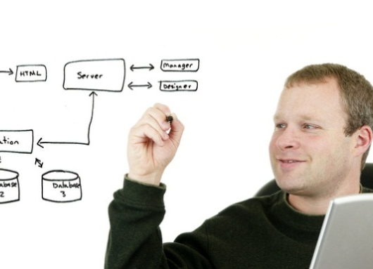
Activity
SCENARIO:
You are having difficulty getting signoff on your requirements package because:
Reviewers who have not participated until the last minute are ‘holding it hostage’
Different sides of the business are not in agreement
QUESTIONS:
1. What will you do now?
2. How will you avoid this in future?
Notes:
DO:
Assign participants to small groups of four or five. Make sure they are NOT in the same groups from the previous activity. Mix them up to keep it interesting.
Review the scenario and questions on the slide.
Give the groups 10 minutes to talk.
Reconvene and have each small group share their ideas with the larger group.
ASK:
What else can go wrong during the approval process?
How can you ensure a successful approval process?
Who is responsible for obtaining signoff?
After the discussion, go to the next slide to debrief.

Slide 60
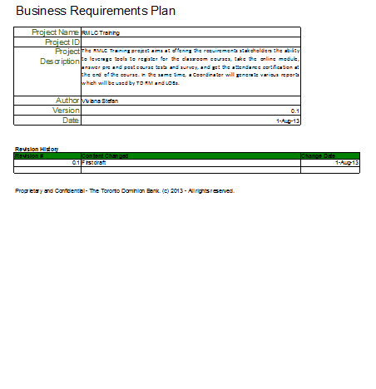
Ensuring Successful Signoff
The Project Manager is responsible for obtaining signoff on all project artifacts including the Requirements Package
Notes:
DO:
Debrief using this slide.
Open the Requirements Management Plan Sample.
Navigate to the ‘Signoff’ tab.
Review the section.
KEY TALKING POINTS:
There is a Signoff tab in the Requirements Management Plan. You will execute signoff based on this plan.
Things that can go wrong:
Reviewers who have not participated until the last minute hold the Requirements Package hostage by not signing off
Different sides of the business are not agreeing and hold the Requirements Package hostage by not signing off
How to set the stage for successful signoff:
Hold interim ‘accountability checkpoints’ (ask ‘are you sure what we have here is accurate?’)
People feel they have more skin in the game
Invite Technology and let them know they need to be there
Who is responsible for obtaining signoff?
The Project Manager is responsible for obtaining signoff on all project artifacts including the Requirements Package.

Slide 61
Wrap Up

